Slide 1
Landice

Slide 2
Elliptical

Slide 3
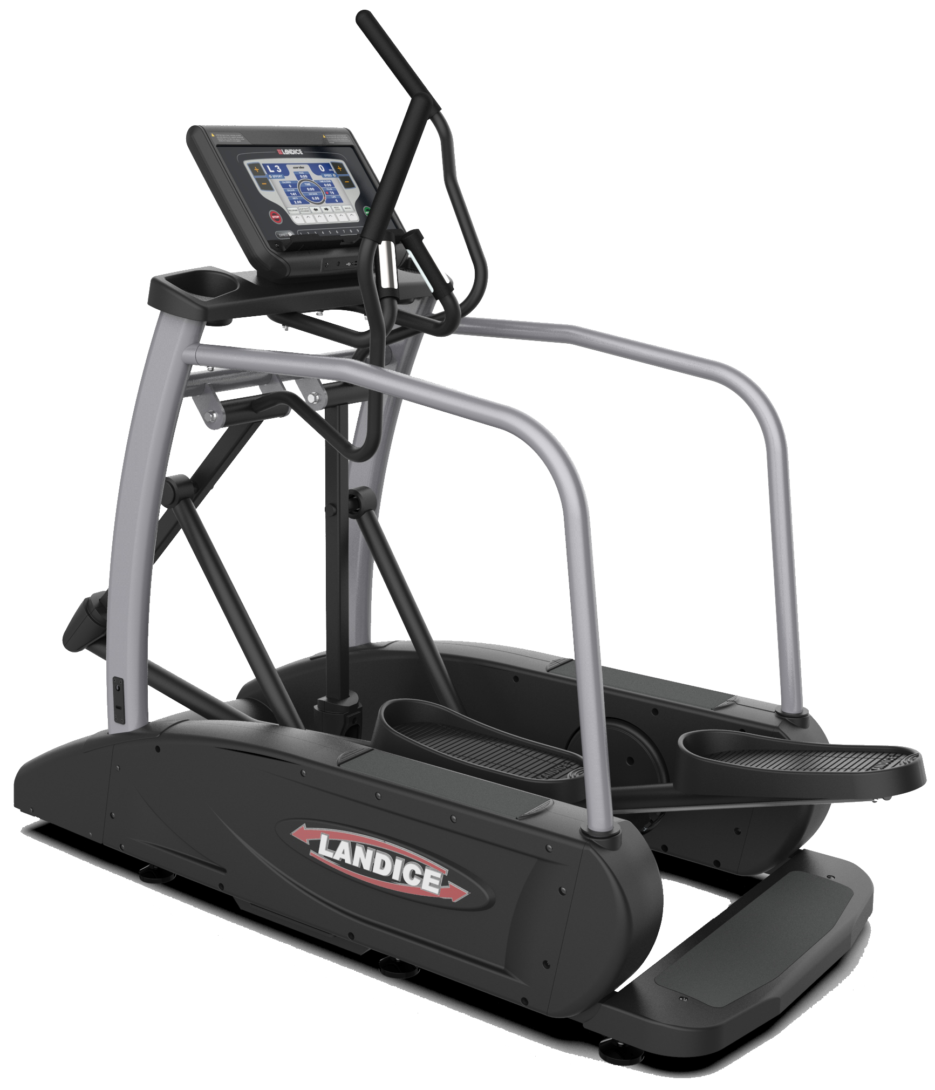
Elliptical
E9 Elliptical
Notes:
In this tutorial, we will be looking at the Treadmill’s...
Key Features
Console Programs

Slide 4
Key Features elliptical Construction
 | E9 Cardio
Weight Capacity | 500 lbs
Dimensions | 35” W x 76” L x 67” H
Handrails | 2” Medical-Grade Side Rails
Drive System | Center Drive
Stride Length | Fixed 21” Stride
Control Panels | Cardio
Equipment Weight | 375 lbs
Power | 110 VAC, 60Hz, 15A 220 VAC, 60Hz, 15A (optional)

Slide 5
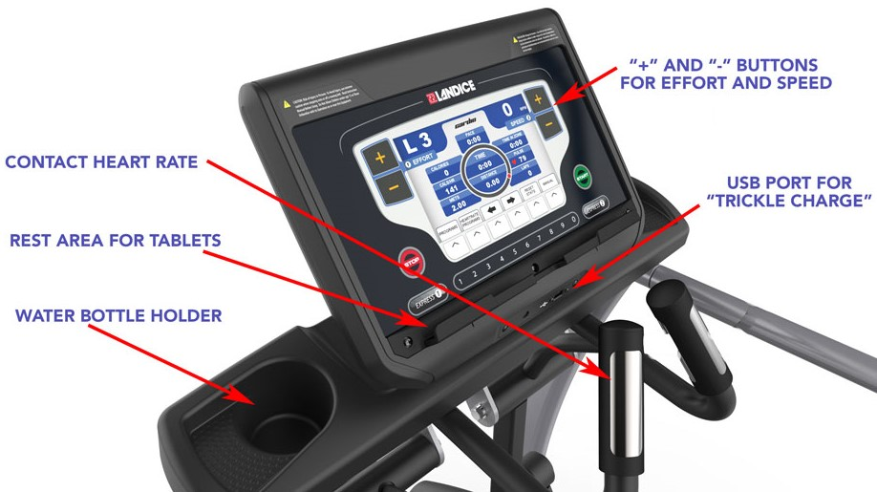
Key Features elliptical Control Center

Slide 6
Elliptical Console Program

Slide 7
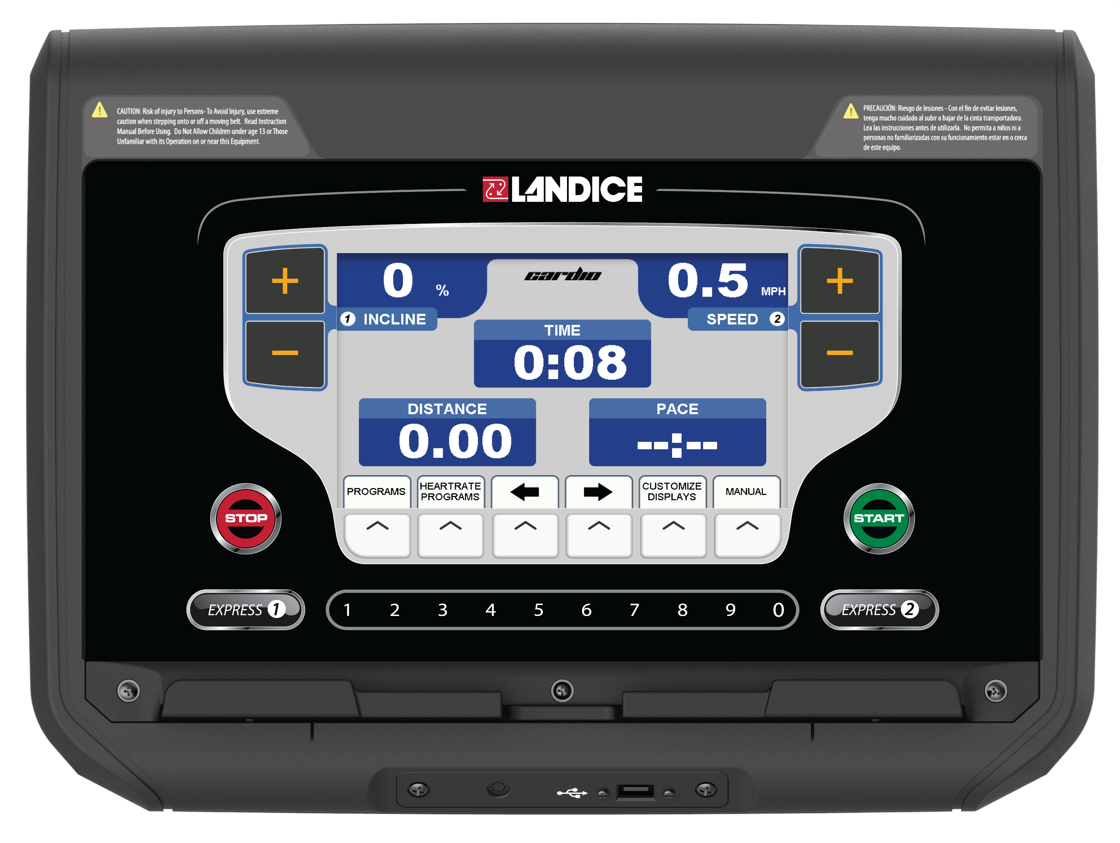
Console Program elliptical Cardio
The Cardio Control Panel combines a variety of program options and multiple heart-rate control programs. These features and options combine to offer an exciting and fun workout so you can reach your fitness goals.
9" color LCD console
Easy data entry
5 Built-in programs with variable time and effort level
5 User-defined programs
Time, distance, and calorie goal programs
3 Fitness tests: Balke, Firefighter, Army
Army fitness test feature: Automatic Shift Transmission Technology
2 Built-in heart-rate monitoring programs
2 User-defined heart-rate monitoring programs
Displays data in English or metric configurations
Contact heart-rate monitoring system

Slide 8
Console Program elliptical Control Panel Function
Function | Description
EFFORT | Displays the effort setting of the elliptical.
SPEED | To view your speed in different units: Press SPEED +/– to select MPH, Km/hr, or Revolutions per Minute.
START | Press START to power up elliptical. All displays light and the starting effort level is set to Level 1.
STOP | Press STOP once to pause the elliptical or twice to turn it off. Statistical information is cleared when the elliptical is turned off.
ENTER | To view different screens during workout: Press ENTER or use the arrow keys at any time to choose the display screen that best suits your workout.
MANUAL | The Manual Mode has no limits or parameters to enter. Changes in effort level will only happen by pressing the buttons.
PROGRAMS | To use the built-in and user-defined workout programs: Press PROGRAMS at any time to display the programs selection screen. Use arrow to scroll through the program. Press ENTER to select the desired program. When prompted, enter the program’s specific parameters (Effort, Time) using the arrow keys. Press START to begin the program.

Slide 9
Console Program elliptical Control Panel Function Cont…
Function | Description
PLUS KEY | Press and hold the (+) to increase effort or to switch between units of measurement. Pressing for longer than 2 seconds causes the effort to increase at a faster rate. Release the key when the display shows desired effort.
MINUS KEY | Press and hold the (–) to decrease effort or to switch between units of measurement. Pressing for longer than 2 seconds causes the effort to decrease at a faster rate. Release the key when the display indicates desired effort.
ARROW KEYS | The left and right arrows are used to set values, select programs or display screens.
HEART RATE PROGRAM | To use the Heart Rate Controlled programs, press HEART RATE PROGRAMS at any time. Choose either a built-in or user-defined heart rate program. Heart Rate Control programs automatically adjust the effort in order to maintain a heart rate.
EXPRESS 1 | This key, in conjunction with the numeric keypad, allow you to directly enter a target effort without using the +/– keys. Press EXPRESS 1, then enter the desired value using the numeric keypad. Then press ENTER or wait 3 seconds for the elliptical to adjust to the new settings.
EXPRESS 2 | Select MPH, Km/Hr, or Revolutions per Minute by pressing EXPRESS 2.
The numeric keypad is used to change effort with the EXPRESS 1 input key, enter user settings, and configure programs.

Slide 10
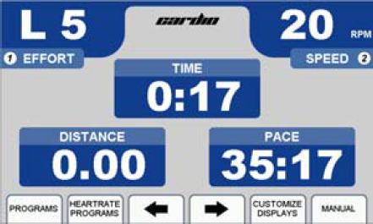
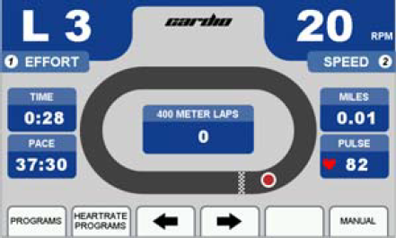
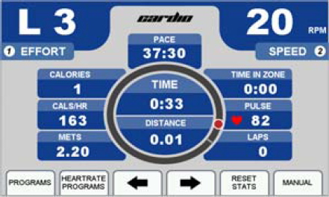
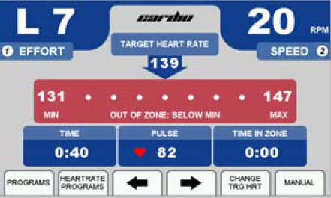
Console Program elliptical Cardio Display Features
Workout information is provided on the Personalized Stats, Track, Statistics, and Heart Rate screens. To toggle between these screens during your workout, press ENTER or use the arrow keys.
Personalized Stats
Track Screen
Statistics Screen
Heart Rate Screen

Slide 11
Console Program Elliptical Cardio Personalized, Track, and Statistics Screens
Feature | Description
EFFORT | 20 levels, select using EFFORT +/– keys
SPEED | Displayed in MPH, Km/Hr, or Revolutions per Minute, select using SPEED +/– keys.
TIME | Time logged on elliptical displayed as “Minutes: Seconds”
DISTANCE | Miles logged on elliptical (kilometers when in metric)
CALORIES | Total calories burned based on user weight
CAL/HR | Rate in calories/hour based on user weight
PACE | Time to complete 1 mile (1 kilometer when in metric)
METS | Current MET level, based on user weight / effort level/ speed. One MET is defined as the energy consumed at rest by the average adult.
LAP (PROGRESS) | A 1/4 mile (400 meter in metric) lap counter.
LAP (COUNTER) | Number of laps completed.

Slide 12
Console Program Elliptical Cardio Heart Rate Screen
Feature | Description
PULSE | Current heart rate
TIME IN ZONE | Time spent in zone. The zone is ± 8 beats from target heart rate
IN ZONE | User’s heart rate is within 8 beats of the target heart rate
OUT OF ZONE | User’s heart rate is outside zone (more than 8 beats above or below target heart rate)
ABOVE MAX | User’s heart rate is above the maximum desirable heart rate
MAX | Maximum allowable heart rate to remain in zone
TARGET HR | Target heart rate (user-defined in Heart Rate Status screen)
MIN | Minimum allowable heart rate to remain in zone
BELOW MIN | User is below minimum allowable heart rate in zone
TIME | The total time of the user’s workout

Slide 13
Console Program Using the Cardio Elliptical
Make sure you have read and understand this owner’s manual before beginning.
Plug the elliptical power cord into its outlet.
Press START. The power-up screen is displayed.
Enter your weight using the numeric keypad or arrows. Press ENTER or wait 3 seconds to advance to the first of the motivational screens.
The elliptical is now ready to use. You can vary the speed reading or effort, if desired, by using the SPEED (+/–) and EFFORT (+/–) keys or EXPRESS 1 and EXPRESS 2 keys.

Slide 14
Console Program Using the Built-In Programs
The 5 Built-in Programs differ in effort. Each lets you select a maximum effort and a time (10 to 99 minutes). (Intervals Program requires a minimum effort.) The elliptical will not go above the maximum number unless manually overridden. Each program has 20 segments of equal time, beginning with 3 warm-up segments and ending with 2 cool-down segments. (example, a 40-minute program contains 20 2-minute segments.)

Slide 15
Console Program elliptical Built-In Programs
 | FAT BURN: This program features two peaks along with gradual changes in effort. The overall goal is to raise heart rate, maintain the raised heart rate for most of the workout, then gradually bring heart rate down during the last 3 cool down segments. | INTERVALS: The overall goal is to vary your workout load, taking you from peak level to recovery 8 times throughout the workout.
 | INTERMEDIATE: The overall goal of this program is to vary your heart rate by increasing and lowering the effort several times, providingyou with a challenging cardiovascular workout. | ENDURO: This program features a maximum effort. The overall goal is to increase intensity toward a peak without recovery until the cooldown.
 | ADVANCED: The overall goal of this program is to raise your heart rate with high effort levels for an advanced cardiovascular workout.

Slide 16
Console Program Running the Elliptical Built-In Programs
Start a workout.
Press PROGRAMS to display the Programs selection screen.
Select a built-in program by using the arrow to scroll through the list, then press ENTER. You are prompted to enter the following parameters: Maximum Effort: (scales effort curve to maximum effort entered), Program Time (sets total length of time you want program to run), Minimum Effort (INTERVALS Program only).
Enter the Maximum Effort using the numeric keypad or the arrow to select a value, then press ENTER or wait 3 seconds.
Enter Program Time using the numeric keypad or the arrow keys, then press ENTER or wait 3 seconds. The time should be at least 10 minutes and not more than 99minutes.
Press START to begin your workout. The Program Progress Detail screen displays your current segment effort and remaining time.
To view other segments, select the View Other Segments button. Use the arrow keys to move left or right. To exit, press DONE.
Press the buttons below the arrow keys at any time to view any of the other motivational screens during your program overview. When viewing a motivational screen other than the Program Progress Detail screen during a segment change, the display temporarily shows the Program Progress Detail Screen then returns to the original screen. During a segment change, the effort window will flash if there is a change in either.

Slide 17
Console Program Elliptical User Programs
Cardio ellipticals can store up to 5 individual, modifiable user-defined program profiles. A user-defined program looks and runs exactly like a built-in program, but it can be customized to suit the user.
Press the button below PROGRAMS to display the Programs selection screen.
Scroll through the program options by pressing PROGRAMS or use the arrow keys. When USER PROGRAM PREVIEW is shown, press ENTER.
Press ENTER or wait 3 seconds. The screen displays PRESS START TO BEGIN OR EDIT TO SET UP.
Press EDIT. EDIT MODE requires a time for segment 1.

Slide 18
Console Program elliptical User Programs Cont…
Note: Press SWITCH FOCUS to toggle between effort and time values for the current segment. To change segments, press NEXT SEGMENT or PREVIOUS SEGMENT. You can change segments in either the forward or reverse direction.
Use the numeric keypad to change the value and press SWITCH FOCUS. Continue to another segment by pressing the next or previous segment keys.
If you want a program to have less than 20 segments, create the last segment with 0 in the time field. The time reads END. The program ends when it reaches this segment.
When you finish editing your User-Defined Program, you can begin your program by pressing START or DONE.
Note: If you attempt to advance the cursor past the 20th segment, you are prompted with PRESS START TO BEGIN OR EDIT TO SET UP. You can also exit Edit Mode by pressing MANUAL MODE or PROGRAMS at any time.

Slide 19
Console Program elliptical Specific Goal Programs
The Cardio Elliptical provides Specific Goal programs. Whether you want to go for 3 miles, burn 1,000 calories, or simply exercise for 15 minutes, the Goal Progress screen accurately assesses your progress with a variety of statistics. During these programs you retain full manual control.
Start a workout.
Press PROGRAMS to display the Programs selection screen and select the goal program you desire.
For TIME GOAL PROGRAM, set a Program Time Goal using the numeric keypad or the arrow keys, then press ENTER or wait 3 seconds.
For DISTANCE GOAL PROGRAM, set a Program Distance Goal using the numeric keypad or arrow keys. Enter a distance from 0.1 to 99.9 miles (km in metric), then press ENTER or wait 3 seconds.
For CALORIE GOAL PROGRAM, set a Program Calorie Goal using the numeric keypad or arrow keys. Enter a calorie goal from 10 to 9,999 calories, then press ENTER or wait 3 seconds.
Press START to begin. The Goal Progress screen shows your Specific Goal (Time, Distance, or Calorie), counting down (noted by a negative sign).
Press ENTER at any time to view any of the other screens during your program.

Slide 20
Console Program Elliptical User Programs
The Cardio Elliptical provides Specific Goal programs. Whether you want to go for 3 miles, burn 1,000 calories, or simply exercise for 15 minutes, the Goal Progress screen accurately assesses your progress with a variety of statistics.
Start a workout.
Press PROGRAMS to display the Programs selection screen and select the goal program you desire (TIME GOAL, DISTANCE GOAL, or CALORIES GOAL), and set the Times, Distance, or Calories goal using the numerical keypad or arrow keys, then press ENTER or wait 3 seconds.
Press START to begin. The Goal Progress screen shows your Specific Goal (Time, Distance or Calorie), counting down (noted by a negative sign).
Press ENTER at any time to view any of the other screens during your program.

Slide 21
Console Program Elliptical Heart Rate Control Program
Landice Cardio ellipticals offer Heart Rate Control (HRC) programs that display your heart rate and automatically vary elliptical effort, allowing you to maximize your workout performance while minimizing your workout time.
You must use the Pulse Grips or the Wireless Chest Strap to detect your heart rate during the HRC programs.
There are 2 different 20-segment HRC programs:
HRC varies elliptical effort to keep your heart rate near the target heart rate for the entire workout.
Interval HRC targets different heart rates. It alternates between the target and 80% of the target.

Slide 22
Console Program Elliptical Heart Rate Control Program
Press the HEARTRATE PROGRAMS key. Scroll through the program previews with arrow keys and select HRC or INTERVAL HRC by pressing ENTER.
Using the numeric keypad or arrow keys, select your maximum effort level. Press ENTER or wait 3 seconds.
Use the numeric keypad or arrow keys to enter your target pulse. The elliptical will vary the effort to make you reach this heart rate. Press ENTER or wait 3 seconds.
The display prompts you to set a Program Time using the numeric keypad or center arrow. For HRC, enter a time between 20-99 minutes. This will scale the 20 segments of the program equally throughout your selected time. Press ENTER or wait 3 seconds.
Press START to begin.
User-Defined Heart Rate Monitoring (HRC) programs are available and allow you to set the target heart rate for up to 20 program segments. For more details, see the Elliptical user manual.

Slide 23
Console Program Elliptical Heart Rate Control Program Cont…
Segment | Stage | % of Target Heart Rate
 |  | HRC | Interval HRC
1 | Warm Up | 70 | 70
2 | Warm Up | 80 | 80
3 | Warm Up | 90 | 90
4-18 | Training | 100 | Alternating 80 & 100
19 | Cool Down | 90 | 90
20 | Cool Down | 80 | 80

Slide 24
Console Program Elliptical Fitness Testing
Army 2 Mile Fitness Test – This is a hands-free, complete as fast as you can fitness assessment run. Fitness Protocols come equipped with Automatic Transmission software. As you pedal faster to increase your speed, the elliptical automatically increases the effort level, yielding a faster “running” (MPH) speed. Vice versa, when you slow down, the elliptical automatically decreases effort level, yielding a slower “running” (MPH) speed. Upon completion you will receive an assessment score (0-100).
Balke Fitness Test – This test requires the pulse grips or optional wireless chest strap. This is a heart rate controlled, walking pace, variable effort fitness test. The test increases in difficulty to raise your heart rate. Upon reaching your Target Heart Rate, the test ends and the elliptical calculates your fitness assessment. Parameters cannot be modified. Your age determines the test’s target heart rate and the scaling of the fitness assessment.
Firefighter (Gerkin) Fitness Test – This test requires the Wireless Chest Strap. It is a heart rate controlled test with variable effort. The test increases in difficulty to raise your heart rate. When you reach your target heart rate, the test ends and the elliptical calculates a fitness level based on your performance. Your age determines the test’s target heart rate and the scaling of the fitness assessment.

Slide 25
Console Program running the Elliptical Army 2 Mile Fitness Test
Press PROGRAMS to view the programs selection screen. To scroll through the programs, either continue to press PROGRAMS or use the arrow keys.
Select the Army 2 Mile Fitness Test by pressing ENTER.
Enter your age (10 to 99) using the keypad or the arrow keys, then press ENTER or wait 3 seconds.
Enter your gender using the center arrow to toggle to MALE or FEMALE. Press ENTER or wait 3 seconds.
Press START to begin.
Complete the 2-mile run as quickly as possible by increasing your pedaling speed. To stop the test at any time, press PAUSE, STOP, MANUAL, HEART RATE PROGRAMS, or PROGRAMS.
When you begin, the Goal Progress screen shows your Specific Goal (Army 2 Mile Run), Time Remaining, Projected Score and other statistics. The Distance counts down. When the test is complete, a US Army assessment rating between 0-100 is displayed, based on your time, age and gender. Use the tables found in the owners manual to interpret your score. PLEASE READ ALL DETAILS IN THE OWNERS MANUAL BEFORE PERFORMING FITNESS TESTS.

Slide 26
Console Program running the Elliptical Balke Fitness Test
Press HEART RATE PROGRAMS to view the HRC programs selection screen. To scroll through the programs, either continue to press HEART RATE PROGRAMS or use the arrow keys. Select the Balke Fitness Test by pressing ENTER.
Use the keypad or arrow to enter your age (10 to 99), then press ENTER or wait 3 seconds.
Enter your gender using the center arrow to toggle to MALE or FEMALE. Press ENTER or wait 3 seconds.
Press START to begin the test.
Upon completion the rlliptical displays your VO2 Max score and fitness assessment based on your performance. Use the tables found in the owners manual to interpret your score based on age and gender. PLEASE READ ALL DETAILS IN THE OWNERS MANUAL BEFORE PERFORMING FITNESS TESTS.

Slide 27
Console Program running the Elliptical Firefighter (Gerkin) Fitness Test
Press HEART RATE PROGRAMS to view the HRC programs screen.
Scroll through the programs using the arrow keys or by continuing to press HEART RATE PROGRAMS.
Press ENTER to select the Firefighter Fitness Test.
When prompted, use the keypad or arrow keys to enter your age (10 to 99), then press ENTER or wait 3 seconds.
Enter your gender by using the arrow keys to toggle between MALE and FEMALE. Press ENTER or wait 3 seconds.
Press START to begin.
Upon completion the treadmill displays a VO2 Max score and fitness assessment based on your performance compared to the general population. PLEASE READ ALL DETAILS IN THE OWNERS MANUAL BEFORE PERFORMING FITNESS TESTS.

Slide 28
Thank you

